Slide 1
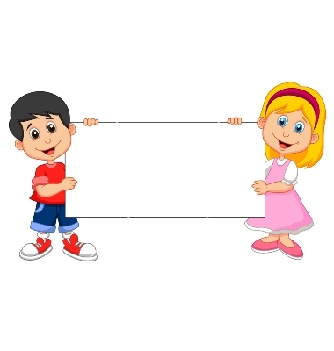

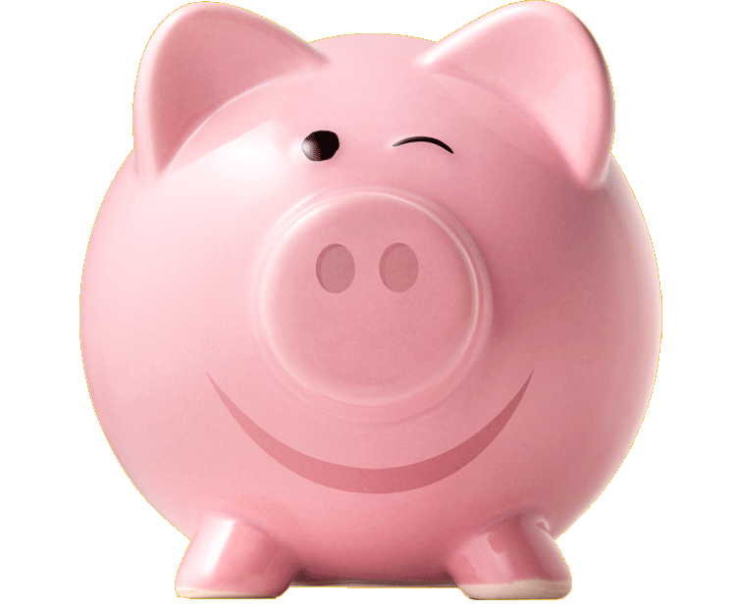
Donation
(Unwilling Piggybank)

Slide 2
Boys Version
Familiarization Task

Slide 3
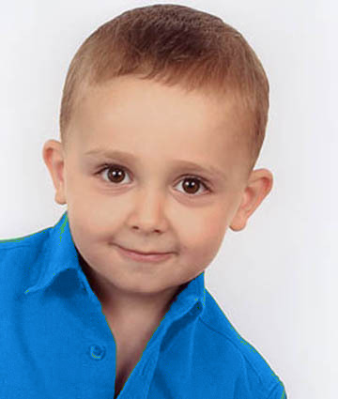
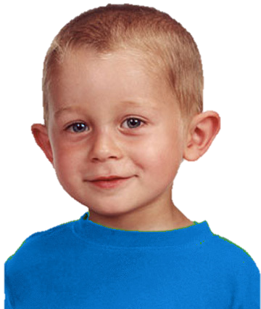
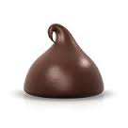
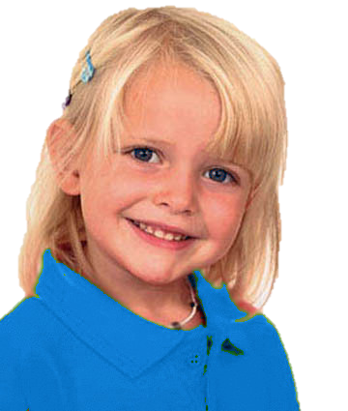
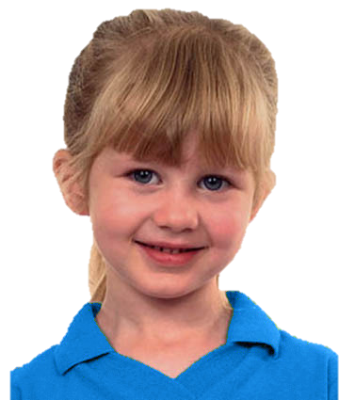
Introduce the group & the piggybank

Slide 4
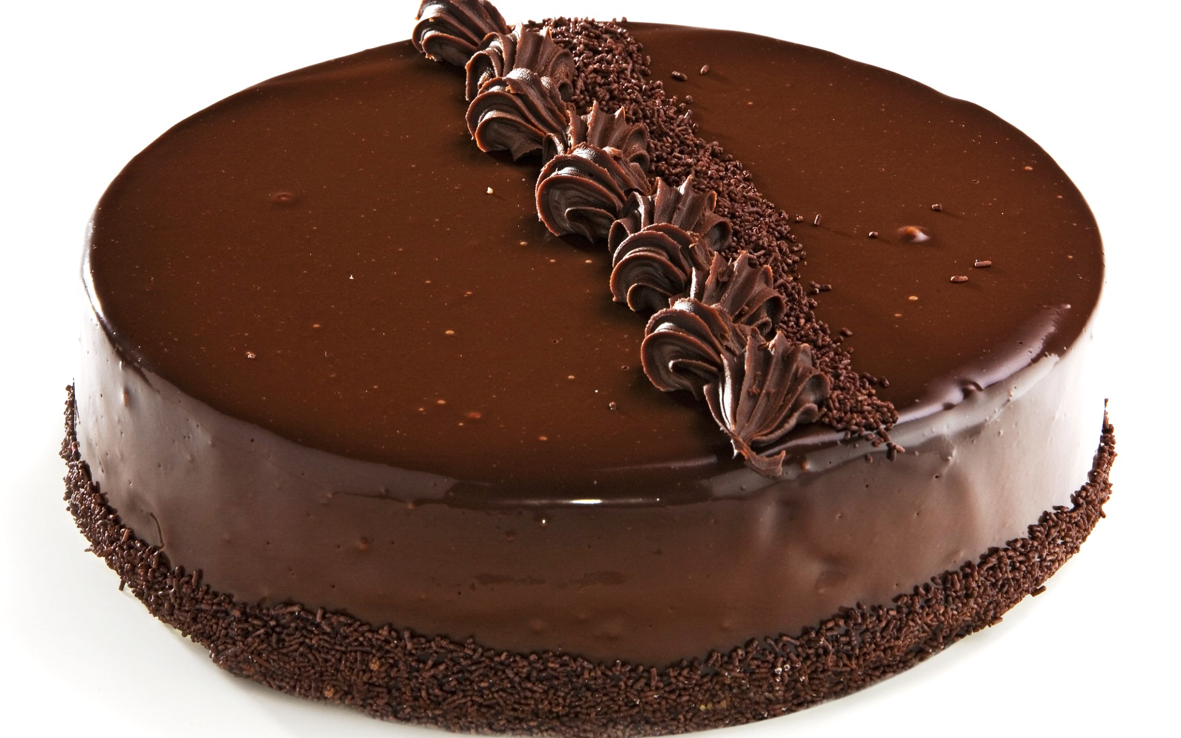
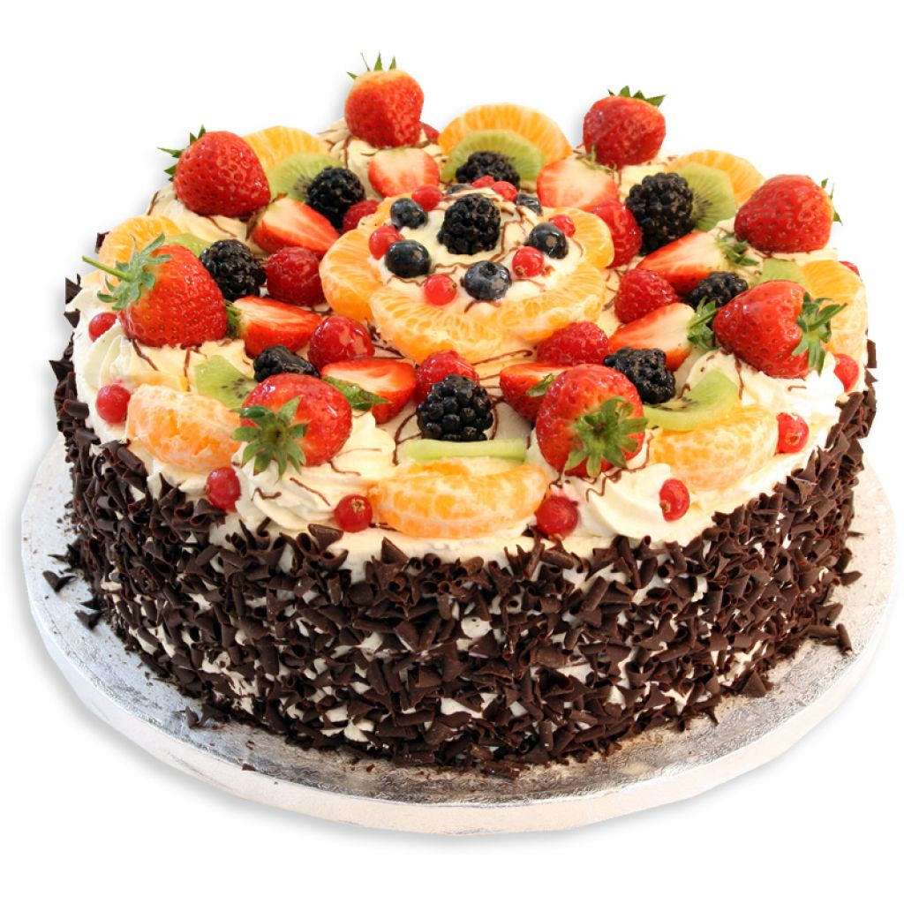
Explain how the piggybank works

Slide 5
Questions & feedback

Slide 6
Test Task

Slide 7
The group goal: have a big cake and share it

Slide 8
Unwilling free-rider (upper left):
Doesn’t want to put his chocolate into the piggybank; he eats it

Slide 9





Slide 11
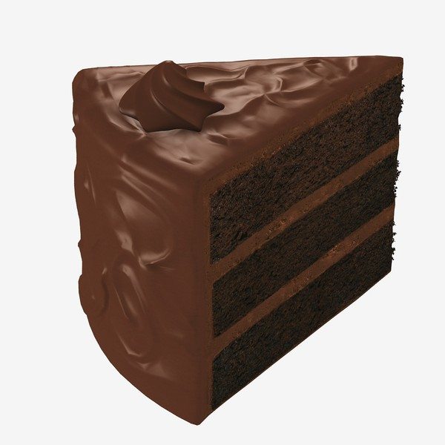
The outcome
The outcome: The piggy bank makes a small cake. Each kid gets a piece of it.

Slide 12
Test Questions
F
C

Slide 13
Unwilling Free-Rider Reminder:
Didn’t want to put his chocolate into the piggybank and ate it.

Slide 14

Evaluation: is he good or bad?

Slide 15
Evaluation: a little good/bad or really good/bad?

Slide 16


Preference: Do you like him or you don’t like him?

Slide 17


Preference: do you like him a little or a lot? do you kind of don’t like him or really don’t like him?
To Contributor

Slide 18
Contributor Reminder:
Wanted to put his chocolate into the piggybank and put it there.

Slide 19
Evaluation: is he good or bad?

Slide 20
Evaluation: a little good/bad or really good/bad?

Slide 21
Preference: Do you like him or you don’t like him?

Slide 22
Preference: do you like him a little or a lot? do you kind of don’t like him or really don’t like him?
To Free-Rider

Slide 23
Girls Version
Familiarization task

Slide 24
Introduce the group & the piggybank

Slide 25
Explain how the piggybank works
Notes:
the more chocolate you put in, the bigger the cake will be.
For example, If 3 kids put their chocolates in, it’ll make a cake like this (pointing). If all 4 kids put their chocolate in, it’ll make a bigger cake like this (pointing).

Slide 26
Questions & feedback

Slide 27
Test task

Slide 28
the group goal: have a big cake and share it

Slide 29
Unwilling free-rider (upper left):
Doesn’t want to put her chocolate into the piggybank; she eats it

Slide 30
The outcome: The piggy bank makes a small cake. Each kid gets a piece of it.

Slide 31
Test Questions
F
C

Slide 32
Unwilling Free-Rider Reminder:
Didn’t want to put her chocolate into the piggybank and ate it.

Slide 33
Evaluation: is she good or bad?

Slide 34
Evaluation: a little good/bad or really good/bad?

Slide 35
Preference: Do you like her or you don’t like her?

Slide 36
Preference: do you like her a little or a lot? do you kind of don’t like her or really don’t like her?
To Contributor

Slide 37
Contributor Reminder:
Wanted to put her chocolate into the piggybank and put it there.

Slide 38
Evaluation: is she good or bad?

Slide 39
Evaluation: a little good/bad or really good/bad?

Slide 40
Preference: Do you like her or you don’t like her?

Slide 41
Preference: do you like her a little or a lot? do you kind of don’t like her or really don’t like her?
To Free-Rider

